Slide 1
BS3 Community Impact Reporting: A Holistic Approach to Wellbeing

Slide 2
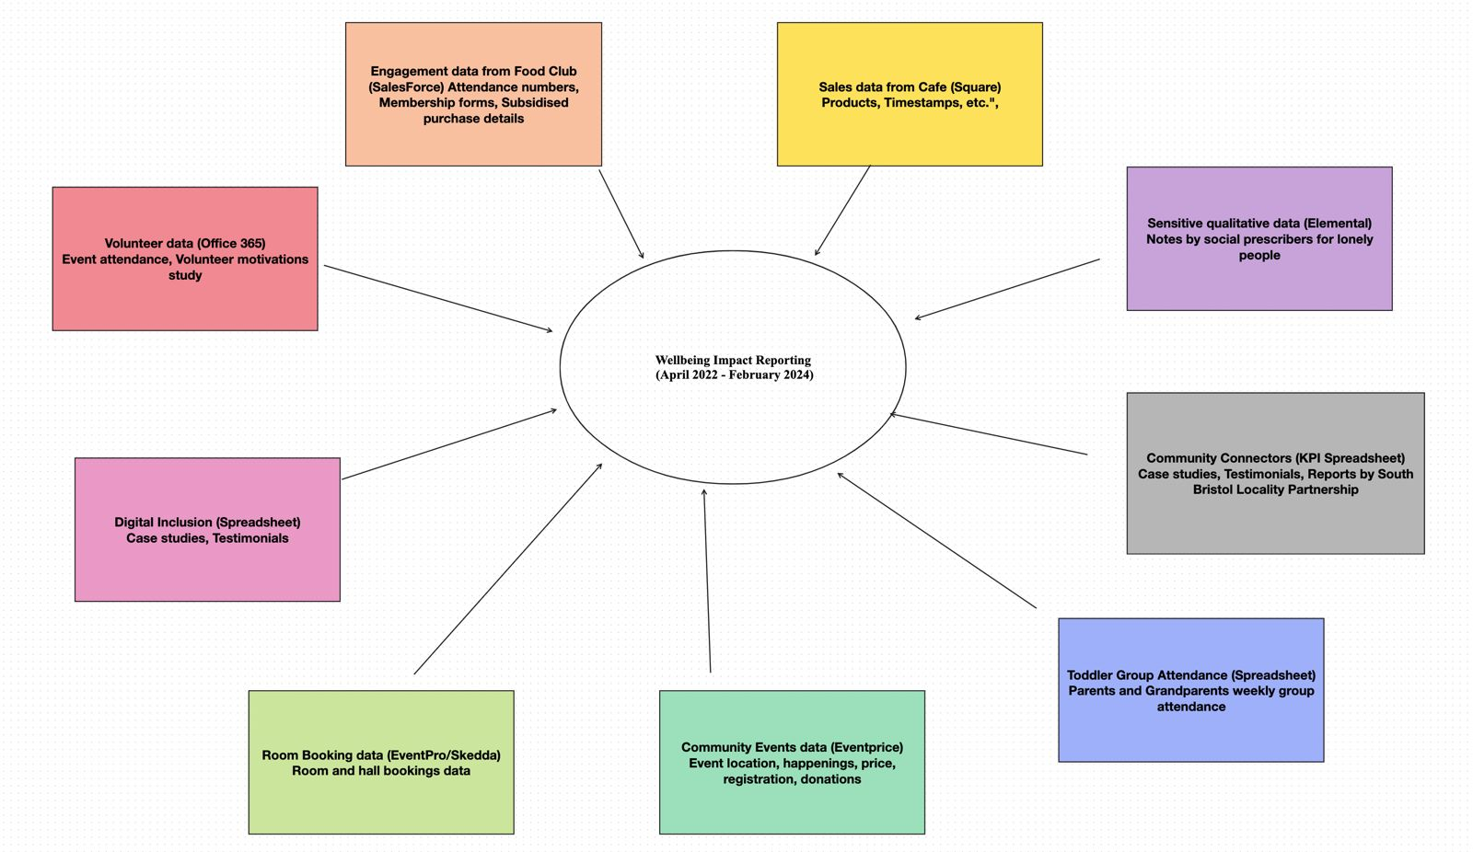

Slide 3
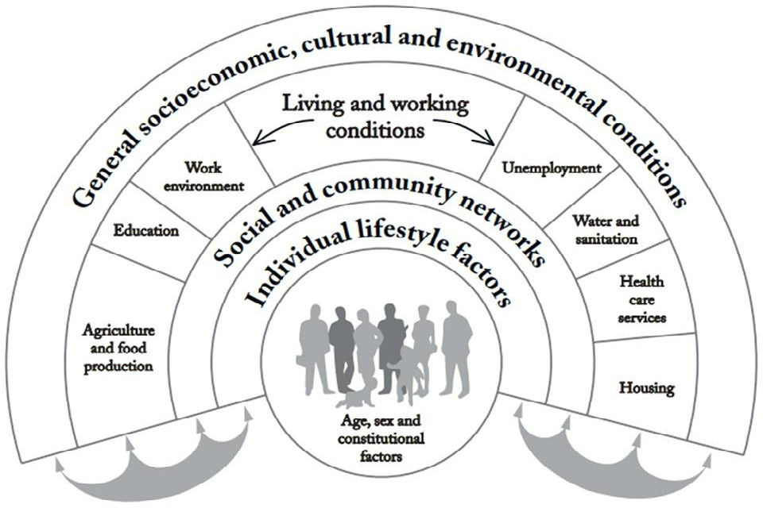
Wellbeing
Social
Environmental
Community
Emotional
Intellectual
Physical

Slide 4
Presentation Flow
Food Club and Social Prescribers – Chinmay Malhotra
Digital Inclusion and Room Hire – Hanish Roshan Rajan
Community Connectors and Community Events Sales – Peter Yu
Café Sales and TAGG – Yi Zhu

Slide 5
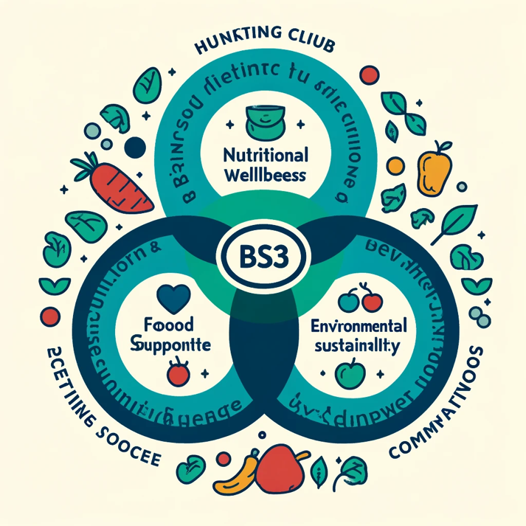
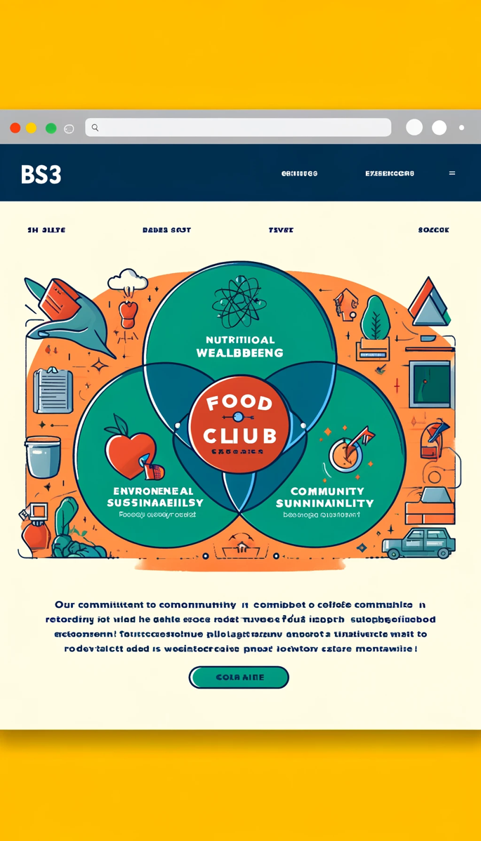
Food Club Data
Initial brief about the initiative.
Interactive goals visualization (Venn Diagram).

Slide 6
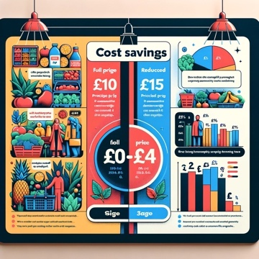
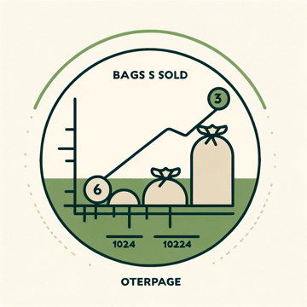
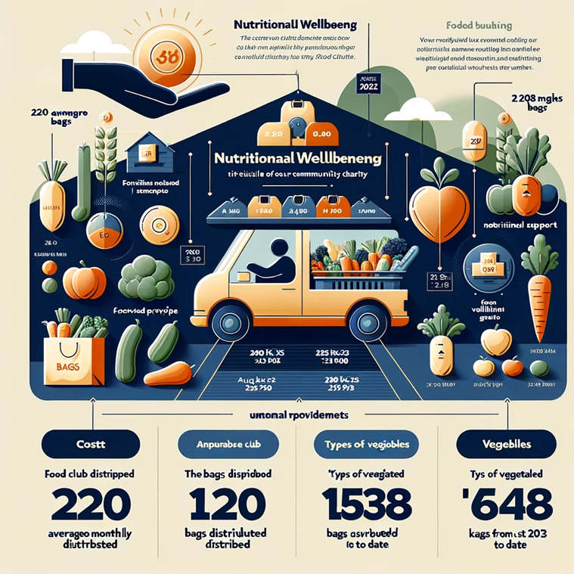
Nutritional Wellbeing
220 bags average monthly (Icon)
Graph to show the growth of bags sold (Graph)
1538 bags from August 2023 till date (Icon)
“X kgs” provided from August 2023 till date (Icon)
“Y” types of vegetables offered (Icon)
Add different types of food items available on top of the truck e.g., Carbohydrates: 38% Fruit and vegetables: 40% Dairy and alternatives: 8% Protein: 12% Oils and spreads: 1% etc.
Access to a list of vegetables and tinned food items provided.
Cost saving infographic included also in the introductory paragraph of the page.

Slide 7
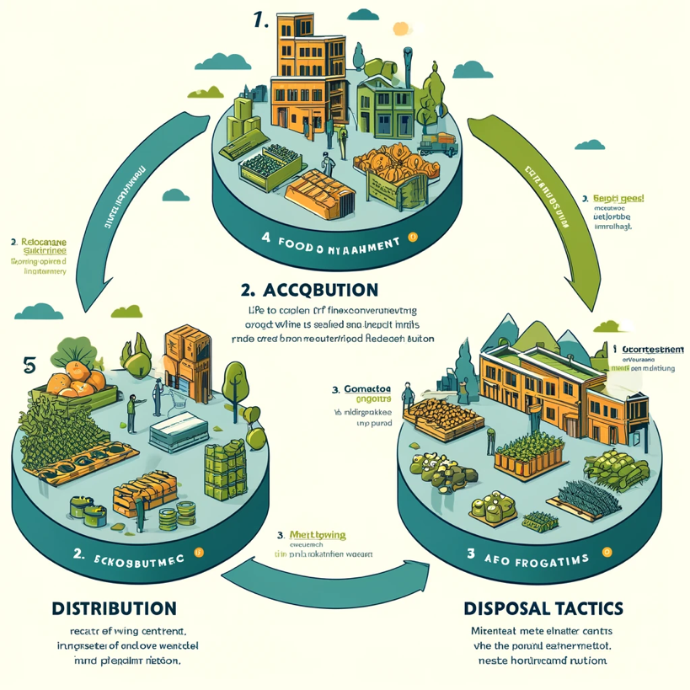
Environmental Sustainability
Lifecycle of Products:
Partner acquisition and collaboration.
Distribution network and hosting centers.
Disposal and sustainability methods.
Nutritional Impact:
Minimal remnants to indicate limited nutritional depreciation.

Slide 8
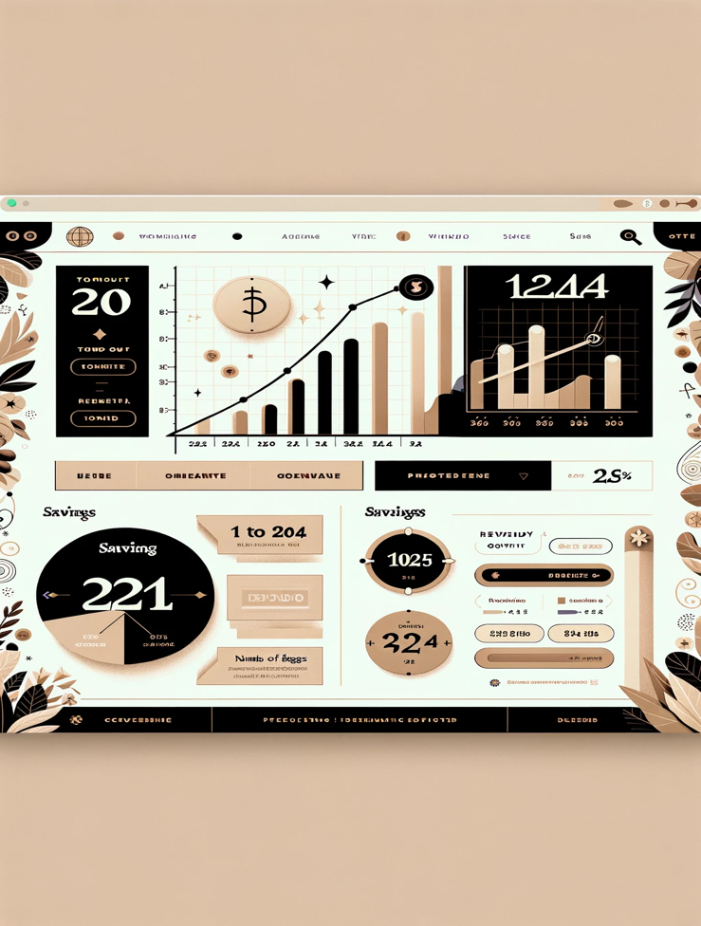
Community Support and Interaction
Analytics:
Predictive trend graphs for turnout rates.
Revenue growth forecasts.
Savings Indicator:
Visual savings representation based on an average £8.50 price difference per bag.

Slide 9
Social Prescribers Data
Introductory Phases:
Phase 1: Introduction to the initiative and partnership with Bridge View Medical.
Phase 2: Outlining aims and goals focused on community health and support.
Page Flow:
Bottom: Introduction in two phases – initiative summary and aims.
Lower section: Interactive icons for case types with testimonials.
Upper section: Pre/post metrics, thematic analysis, testimonies.
Data Visualization:
Top Graphs: Social prescriber growth and monthly average of people helped.
Interactive Graph: Demographics range of served individuals.
KPIs and Roadmap:
Smart icons roadmap.
KPIs: People served (161), visits (420), hours of support, initiative duration.
NLP Tools for Analysis:
NLTK, Gensim, Voyant Tools, KNIME, TextBlob, RapidMiner.

Slide 10
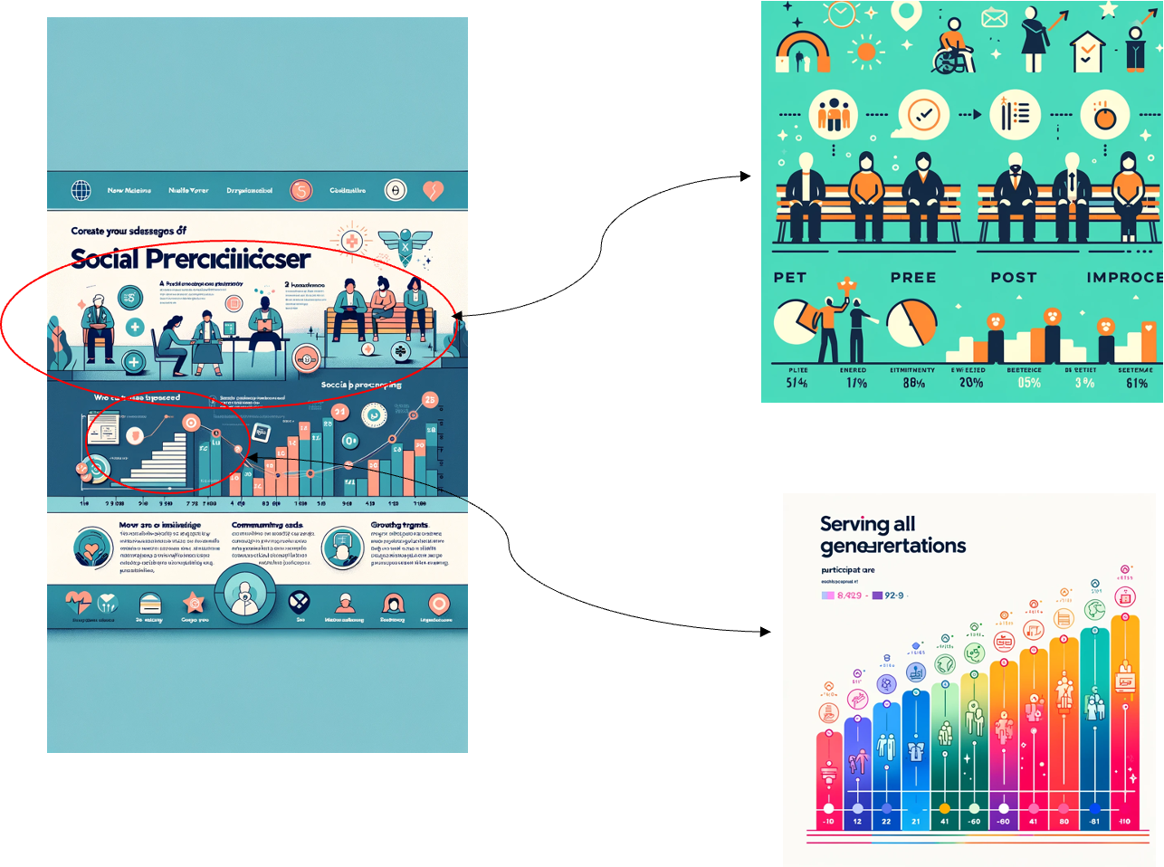

Slide 11
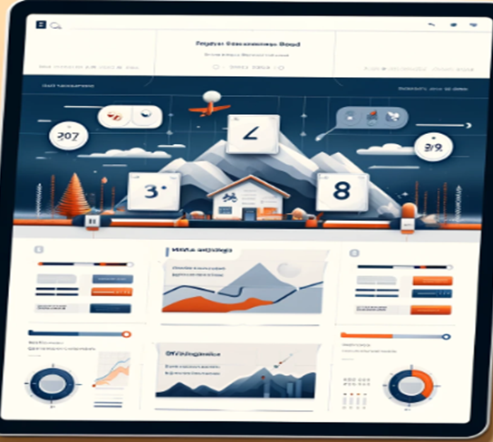
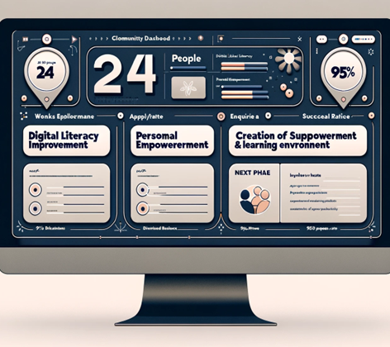
Digital inclusion impact
•Introduction about the digital inclusion project, the courses provided. And mention of St. Monica trust for providing funds.
•The course types available (C1 & C2) and aim/goals can be mentioned and can be demonstrated in small tiles or blocks which will be clickable to see the whole details.
•At the top bubbles we can show KPI metrics based on people’s feedback of average change percentage of people taken the course which would also show success rate.
•Average of 96% change was seen in people “confident using technology”.
•95% change was felt in people who believed “they could contribute to the society” post course.
•People felt safe using internet post course with 90% change rate.
•There was 91% change rate who felt they learned a new skill

Slide 12

THE IMPACT GOALS
Digital Literacy Improvement
•Week 1:
•Tony: 2 (very anxious, significant worries about attending)
•Rita: 4 (social but has never attended any courses or worked before)
•Week 5:
•Tony: 7 (notices a decrease in fear of the digital world, feels more optimistic)
•Rita: 8 (orders Wi-Fi for home, expresses desire to continue learning)

Slide 13
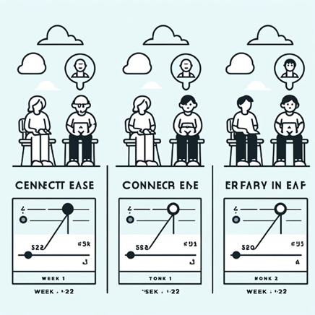
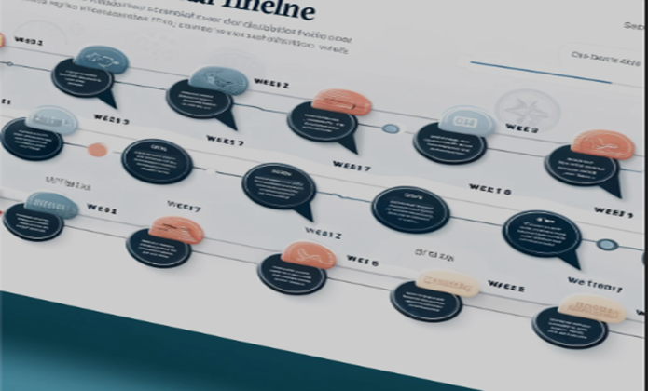
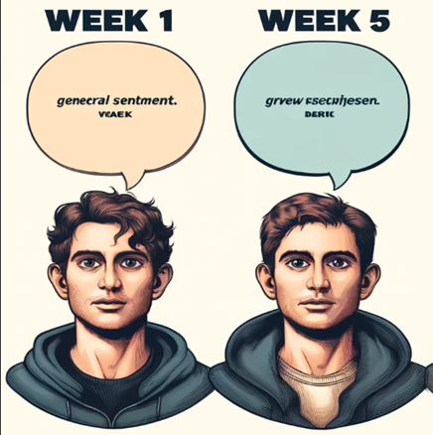
Based on the weekly response from the case study, we can compare the week one response and final week response with infographics of each person. Where its clickable and will take you to another page to show every week response during the course
A Slider can be provided where the quotes pop up when its moved on the selected week. This can show the progress timeline.

Slide 14
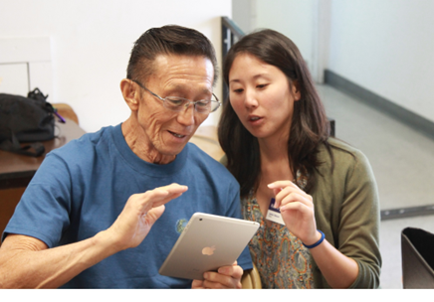

Personal Empowerment & Confidence:
Improvement in Confidence and Skills
Overcoming Fear and Anxiety
Engagement with Digital Tools
Creation of Supportive Learning Environment:
The establishment of a friendly group of mature students, as described by Tony, where participants felt confident to interact and support each other, further facilitated personal empowerment among the course attendees.
iPads are provided by the charity for people to learn as per their convenient.
Both goals can be demonstrated with the feedbacks from the participants.
Post-course feedback highlighted participants' increased understanding and confidence quotes like “This course has given me more understanding and confidence..." and "Definitely a confidence booster" and “I bought my first Christmas Present online “reflect the personal empowerment aspect of the course.
We can show all the post feedback and responses in the bottom of the page which assures that these courses can be trusted and relied on as many people have seen improvement through these courses.

Slide 15
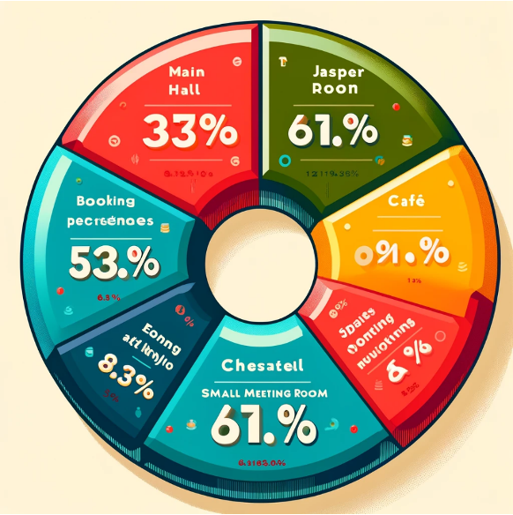
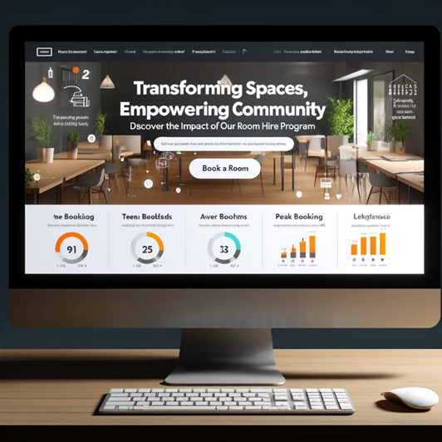




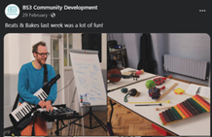
Room Hire Data
Header - “Transforming Spaces, Empowering Community: Discover the Impact of Our Room Hire Program”
Call to Action (CTA) button on right top: include clear CTAs such as “Book a Room,” “Donate,” or “Get Involved.”
Use of infographic or graphs –
A donut chart showing the room usage by type of event e.g., educational, cultural, social, private functions. Shows the diversity of interactions induced by the charity.
showing details of various events conducted by the charity to keep everyone engaged socially creating new connections. Which also makes their time of the day emotionally positive(if conducted in the rooms).
Repeat Bookings: which shows the consistency of people socializing through BS3 room events!
Total successful bookings – 79 (icon)
Total attendance so far– 1838 people
max occupancy in a room – ‘120’ (Milford hall)
Peak day in a week – Tuesdays, Thursdays, and Saturdays
Most demanded room – Jasper room

Slide 16
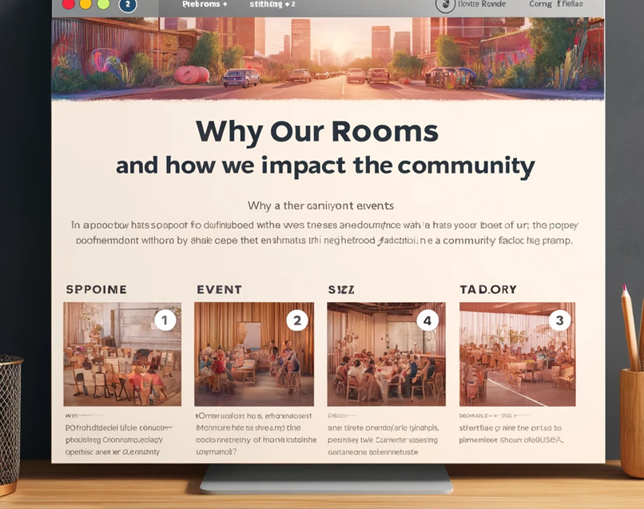
*INFOGRAPHICS HERE*

Slide 17
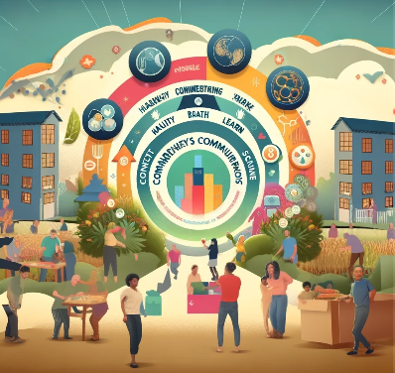
BS3Community Connectors Program
Project Overview:
Mission: Enhance well-being, health, happiness, and connectivity of BS3 residents.
Values: Positivity, Inclusion, Connection.
Approach: Tailored opportunities through listening to community voices.

Slide 18
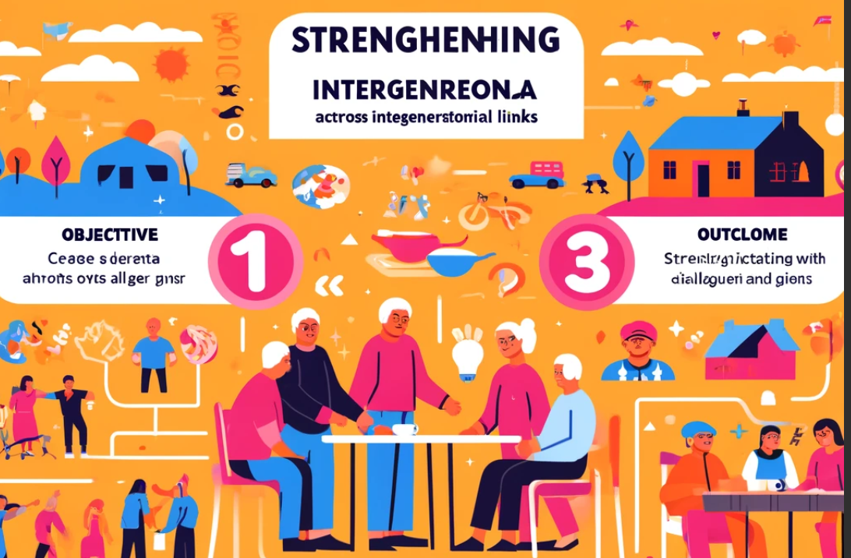
To Strengthen Community Connections and Intergenerational Links
Connectors Participation across age groups with specific targets:
Age 70+: 3 participants
Age 80+: 3 participants
Around age 65: 5 participants
Around age 60: 8 participants
Male:10 Female:14 Unknow:1
BS3 Connectors

Slide 19

Assess improvements in well-being and health
Below are provided types of supports:
Knitting sessions
Connector's session
Art group
Walking support
Stroll and chat
Distribution of Issues Addressed.
Mental Health: 25%.
Accident: 15%.
Isolation:15%.
Stroke: 10%.
Dementia: 10%.
Cancer: 10%.
Low mood: 5%.
Poor mobility: 5%.
Child with additional needs: 5%.
Types of Support

Slide 20
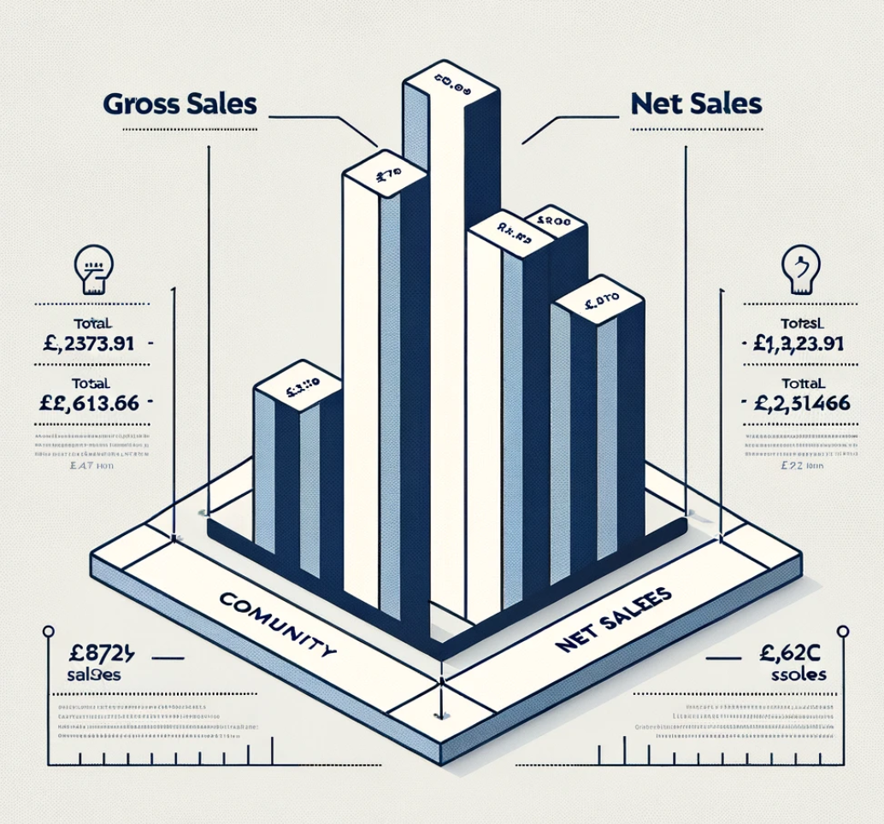
Events Sales Impact Report
To analyze the sales data from community events to understand performance, popularity, and the economic impact on the community.
Total Gross Sales: Highlight the total gross sales amounting to £3,273.91, indicating healthy community interest.
Total Net Sales: Present the total net sales figure of £2,612.66, showcasing successful event execution and community engagement.

Slide 21
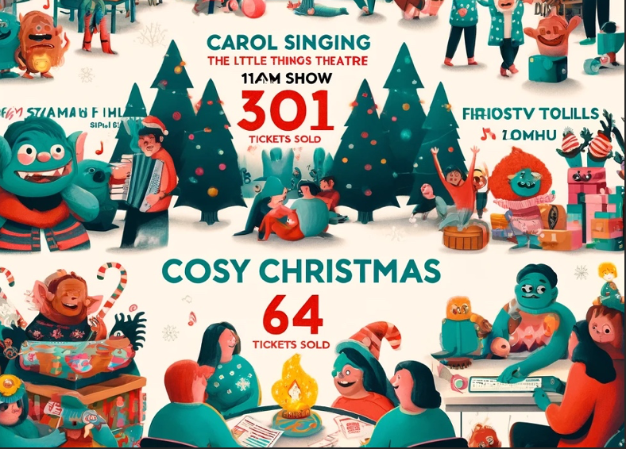
Event Popularity & Community Engagement
Top 5 Events:
Stay & Play: 303 tickets - Emphasize the event's interactive nature and appeal to families.
Christmas Trolls, The Little Things Theatre 11AM Show: 80 tickets - Highlight the interest in holiday-themed performances.
Christmas Trolls, The Little Things Theatre 2PM Show: 74 tickets - Note the continued popularity of festive events.
Cosy Christmas. Carol Singing & Festive Film: The Grinch: 72 tickets - Indicate the community's love for traditional holiday activities.
Cosy Christmas. Festive Films: Elf:
Strengthening community bonds and intergenerational ties during the festive season

Slide 22
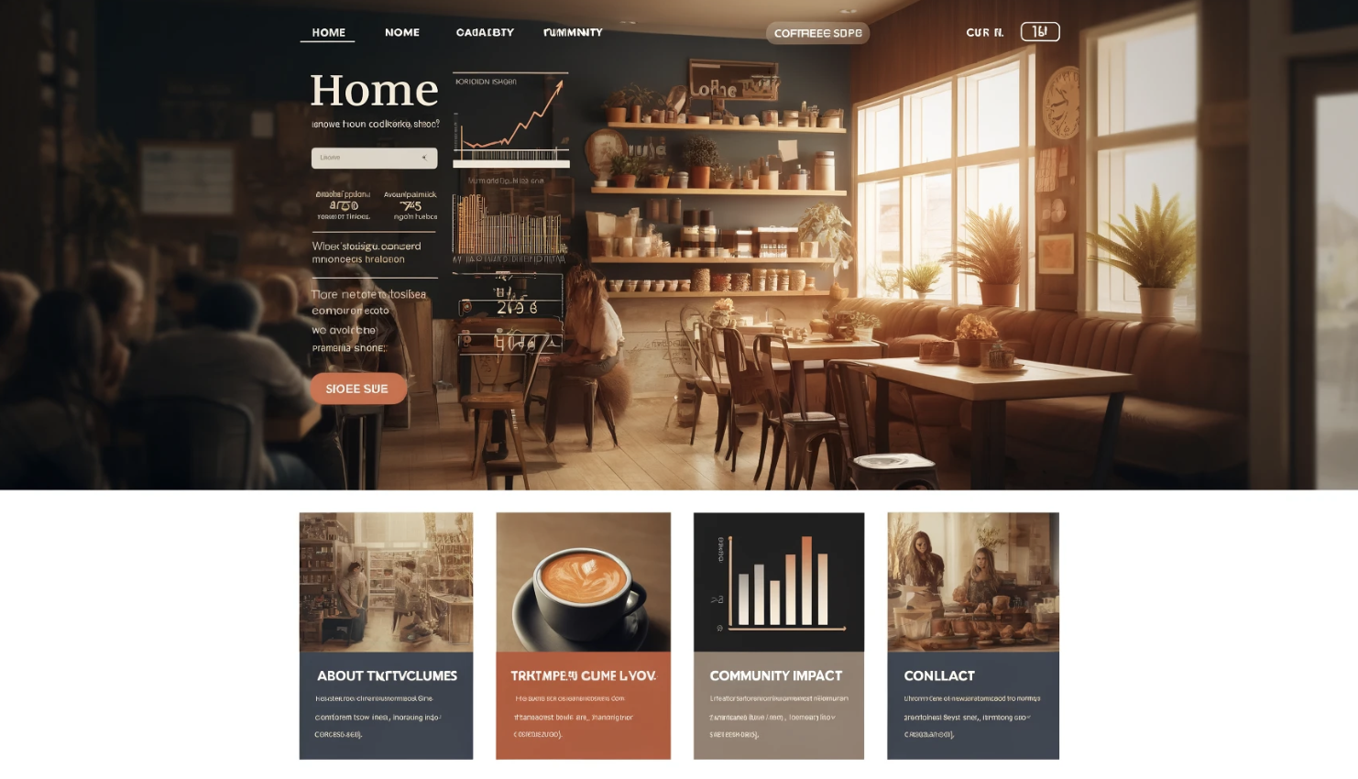
Square Sales Dataset
Notes:
null

Slide 23

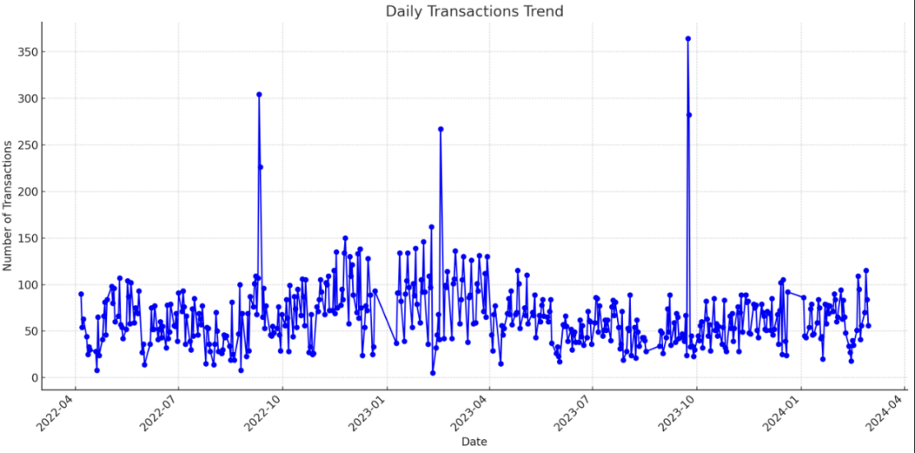
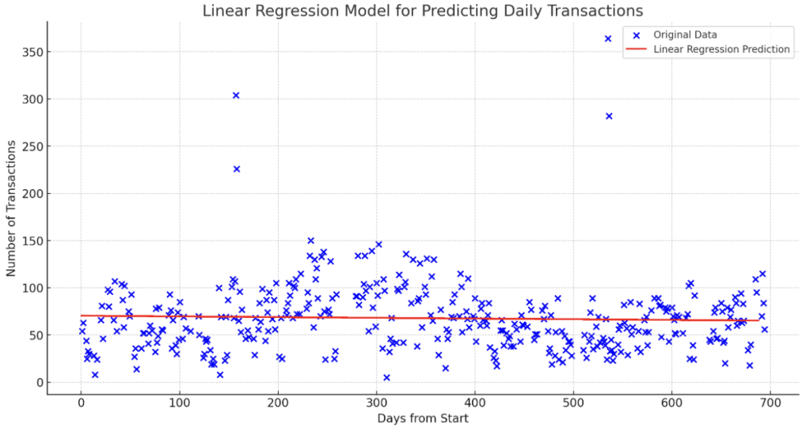
Predicting Future Sales
Daily Transactions Analysis

Slide 24
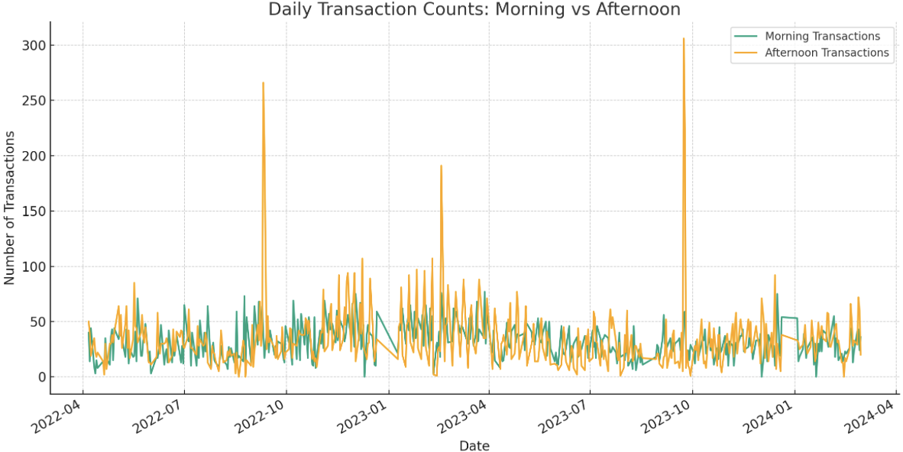
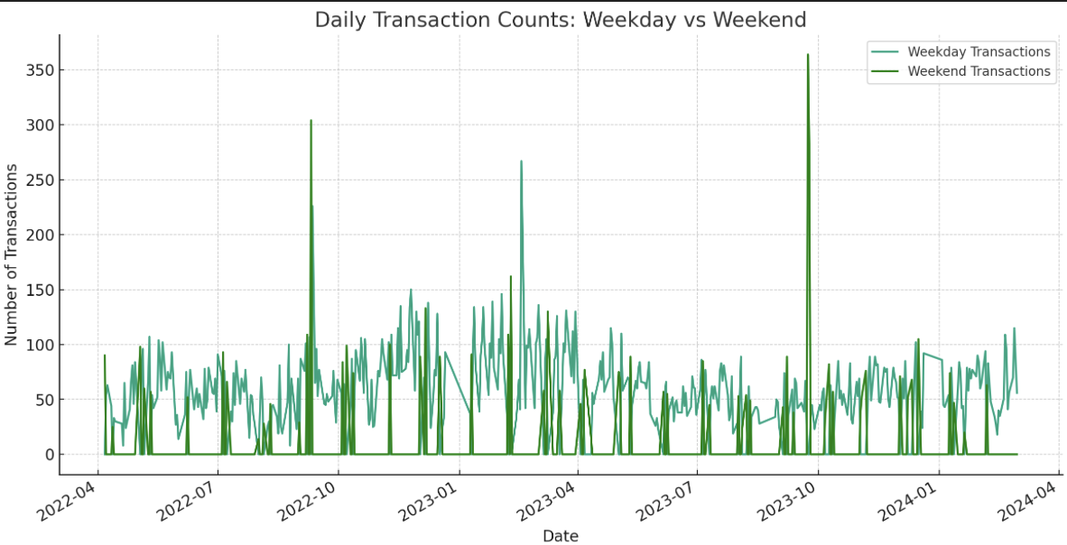
By comparing the coffee shop’s daily transaction volume in the morning vs afternoon and on weekdays vs weekends:
we observed that the coffee shop’s transaction volume increased significantly on weekday afternoons and weekends, indicating that community members tend to place coffee The trend of coffee shops as places to relax and socialize after getting off work not only reflects the role of coffee shops in meeting the daily leisure needs of community members, but also demonstrates their potential to enhance community vitality.

Slide 25

What does the coffee shop do in promoting community well-being?
01
02
03
INCREASE SOCIAL ACTIVITIES
PROMOTE EMOTIONAL CONNECTION
PROMOTE PHYSICAL HEALTH

Slide 26
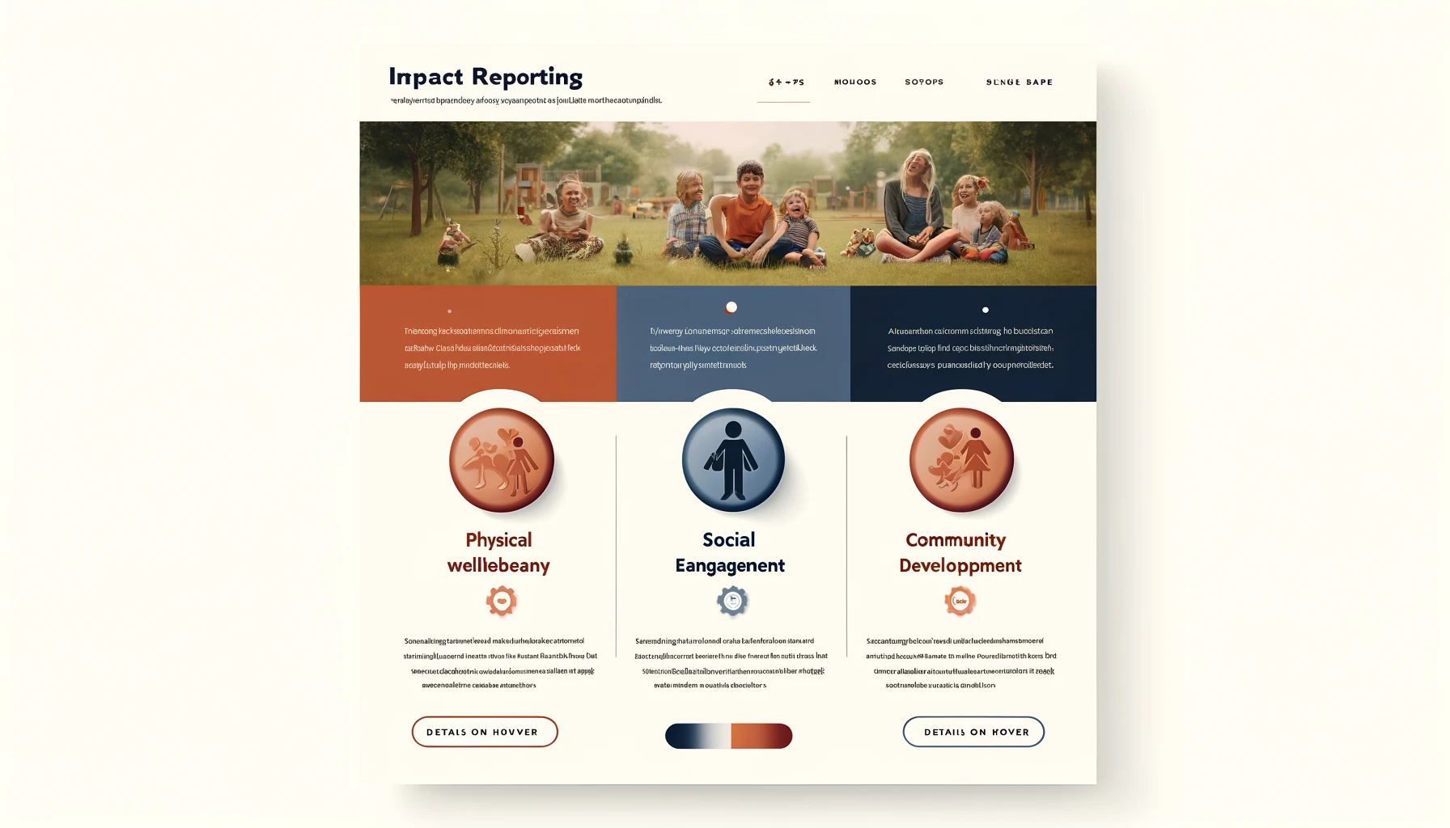
Impact Reporting for Toddler Group Dataset

Slide 27
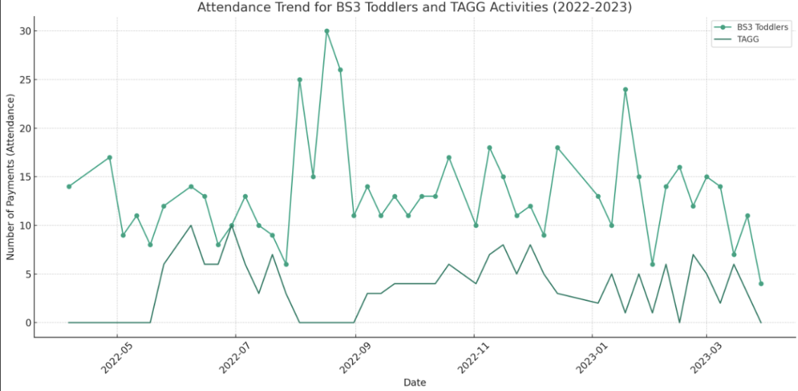

The BS3 Toddlers event is particularly popular, showing strong community participation. The growth in TAGG attendance also shows that new activities can successfully engage community members.
The stable attendance at BS3 Toddlers events, alongside the rising interest in TAGG, indicates a healthy demand for community-driven activities among residents.
Despite data recording challenges, it's evident that these toddler groups play a significant role in enhancing community cohesion and engagement.
ATTENDANCE ANALYSIS
SPECIAL INSTRUCTIONS ANALYSIS
TIME TRENDS

Slide 28


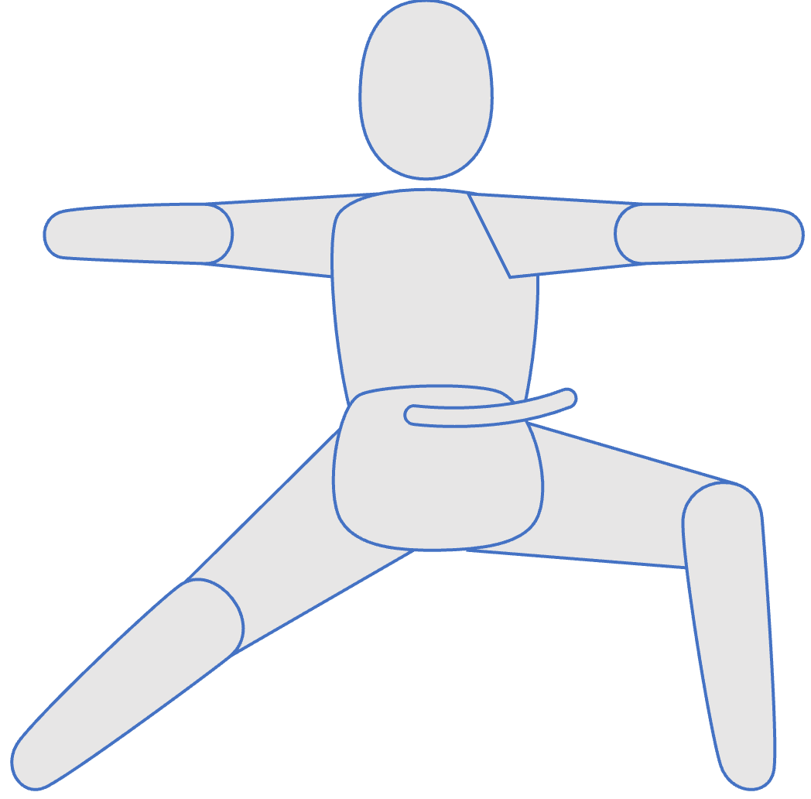

KEY ASPECTS OF IMPROVING COMMUNITY IMPACT
Social
By participating in BS3 Toddlers group events, community members have the opportunity to build and grow their social network.
Intellectual
The activities are designed to encourage participants to learn new skills and knowledge.
Physical
Participation in community activities provides opportunities for active physical activity.

Slide 29
Conclusion: The Circle of Wellbeing
Mission and Charter Commitment
Wellbeing Spectrum Cover
Integrate All Aspects

Slide 30

Questions?

